Slide 1

Text Classification
Sentimental Analysis on Social Media Contents
By : Lohade Sanskruti
Mentor : Mr. Sudheer Kumar

Slide 2
Contents to be presented:
Text Classification Introduction
Why Text Classification ?
Multi - Class Imbalance
Approach for Text Classification
Traditional Machine Learning Models
Performance Metrics
Sentimental Analysis using Lexicon based approach
Conclusion
References

Slide 3
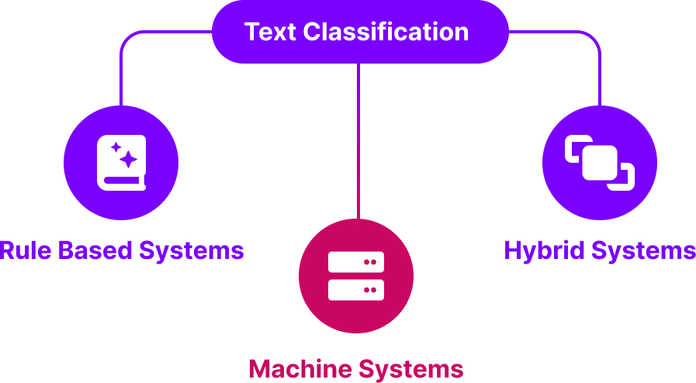
Text Classification Introduction
Text classification, also known as text categorization, is a fundamental task in natural language processing (NLP) that involves assigning predefined categories or labels to textual data. Classification is a two-step process, learning step and prediction step, In machine learning, in the learning step, the model is developed based on given training data and in the prediction step, the model is used to predict the response for given data.

Slide 4
Why Text Classification ?
The content we see in our day to day life is in various languages. For data mining, we need to work with every language. So we came up with the concept of text categorization System also termed as Text Classification or Topic Spotting. If we manually categorize the content, then it is impossible for such large datasets. Thus, Text Classification Systems are important. Accuracy and efficiency is maintained.
Examples : 1. Sentimental Analysis
2. Language Detection
3. Content Filtering (Usually happens in Gmail by separating spam section from primary mail section.)

Slide 5
Business Use Cases:
Customer Support Automation:
a) Ticket Categorization b) Sentimental Analysis
Content Moderation:
a) Spam Detection b) Inappropriate Content Detection
Marketing and Sales
Product and Service Feedback
E – commerce
Implementing text classification in these areas can greatly enhance efficiency, improve customer satisfaction, and provide valuable insights for business decision-making

Slide 6
About dataset
The Emotions.csv dataset consists of two columns: text data and labels, where the labels range from 0 to 5, indicating different emotion categories. The dataset contains a total of 16000 entries.
A significant challenge is the class imbalance, with some emotion categories being underrepresented compared to others. This imbalance may affect the performance of classification models, necessitating techniques like resampling or weighted loss functions to address it. Proper handling of this imbalance is crucial for achieving reliable and accurate classification results.

Slide 7
Multi - Class Imbalance:
Multi-class imbalance is a condition in a dataset where the number of instances across different classes is not evenly distributed. This means that some classes (categories) have significantly more instances than others.
Steps to Identify Class Imbalance:
Frequency Count:
Calculate the frequency of each class in the target variable.
Compare the counts to see if there is a significant disparity between classes.
Visualize the Distribution:
Use visualization techniques such as bar plots to visually inspect the distribution of the classes.
Calculate Imbalance Ratios:
Compute metrics that quantify the degree of imbalance, such as the imbalance ratio.

Slide 8
Handling Imbalance:
Resampling Techniques: Apply oversampling techniques like SMOTE or undersampling techniques to balance the class distribution.
Class Weights: Adjust class weights in algorithms to give more importance to the minority class.
Ensemble Methods: Use methods like Balanced Random Forest or EasyEnsemble that are designed to handle class imbalance.

Slide 9
Approach for Text Classification:
Step | Action
Data collection | Gather a comprehensive dataset relevant to the problem.
Text preprocessing | Clean and normalize text data (tokenization, removing stopwords, stemming).
Feature engineering | Convert text into a numerical format (TF-IDF, word embeddings).
Model selection | Choose an appropriate algorithm (naive bayes, SVM, deep learning models like LSTM, CNN).
Model training | Train the model on the processed data.
Evaluation | Assess model performance using metrics (accuracy, F1 score).
Hyperparameter tuning | Fine-tune model parameters for optimal performance.
Deployment | Deploy the model for real-world applications.

Slide 10
Text Preprocessing:
It involves the transformation and cleaning of raw data to prepare it for modeling. This process ensures that the data is in a suitable format for analysis, enhancing the accuracy and efficiency of machine learning algorithms.
Techniques:
Tokenization
Stopword Removal
Stemming
Lemmatization
Text Normalization
Vectorization
Handling Text Imbalance
Text Cleaning

Slide 11
Traditional Machine Learning Models:
Naïve Bayes Classifier
Support Vector Machines (SVM)
Logistic Regression
Decision Trees and Random Forests
Gradient Boosting Classifier (XGBOOST)

Slide 12
Naïve Bayes Classifier
Support Vector Machines (SVM)
Naive Bayes classifiers are probabilistic models based on Bayes' theorem, assuming independence between features.
SVMs find the hyperplane that best separates data points of different classes with the maximum margin. They can be used for linear and non-linear classification through kernel tricks.
Logistic Regression
Random Forests
It models the probability that a given input belongs to a particular class using a logistic function (sigmoid function).
Random forests are an ensemble method that combines multiple decision trees to improve performance and reduce overfitting. Each tree is trained on a random subset of the data and features.

Slide 13
Gradient Boosting Classifier (XGBOOST):
GBMs build an ensemble of decision trees sequentially, where each tree tries to correct the errors of the previous trees.
XGBoost is an optimized implementation of gradient boosting that includes regularization, parallel processing, and other enhancements to improve speed and performance. XGBoost is currently the dominant algorithm for building accurate models on conventional data (also called tabular or structured data).

Slide 14
Performance Metrics:
Performance metrics can be used to evaluate the effectiveness of your model. These metrics help you understand how well your model is performing and where it might need improvement.
Common Performance metrics for text classification:
Accuracy
Precision, Recall, and F1 Score
Confusion Matrix
ROC Curve and AUC

Slide 15
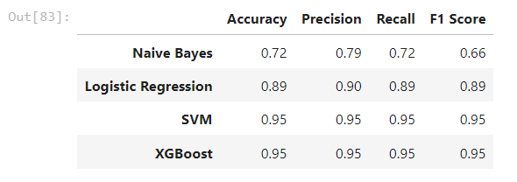
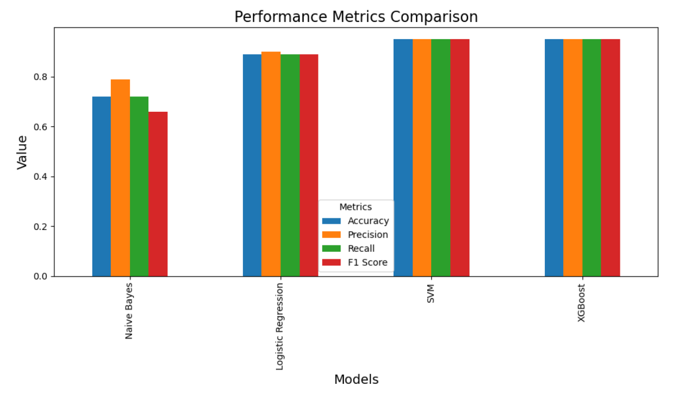
Modelling Results:

Slide 16
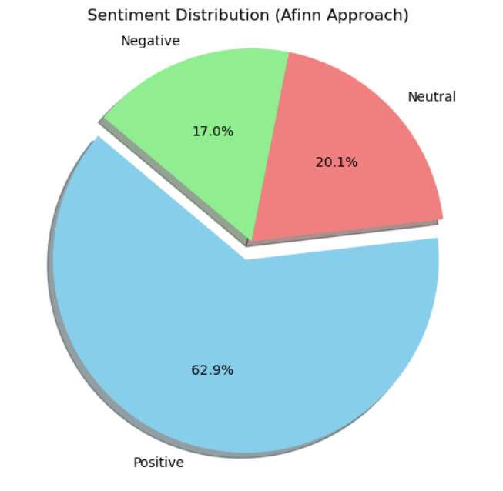
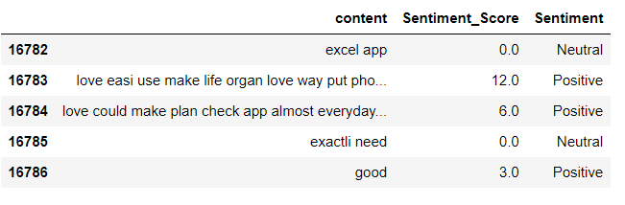
Sentimental Analysis using Lexicon based approach:
Lexicon-based sentiment analysis is a technique used in natural language processing to detect the sentiment of a piece of text. Lexicons like AFINN, SentiWordNet, or VADER are commonly used for sentiment analysis.

Slide 17
Conclusion:
In conclusion, the tasks we worked under Infosys Springboard Internship effectively applied lexicon-based models for sentiment analysis and performed Text classification. For text classification, the study addressed the challenges of multi-class imbalanced data within a supervised dataset. Various models were implemented and evaluated using performance metrics, with classification reports generated for each model. Among all the models tested, Support Vector Machine (SVM) and XGBoost demonstrated superior performance.

Slide 18
References:
https://monkeylearn.com/text-classification/#:~:text=Tutorial-,What%20is%20Text%20Classification%3F,and%20all%20over%20the%20web
https://www.geeksforgeeks.org/what-is-the-right-approach-for-text-classification-problems/
https://youtu.be/E3MAVkitm28?si=v5jeRDWKGnCR8dmK
https://youtu.be/r7qS9mKVLdw?si=oqpIg-i_6UQ5wYQx
https://youtu.be/ZKkEQSpRgCs?si=yIVmK1WgeRCxgZpF

Slide 19
Thank you ( Q & A )

